Slide 1
Authorization pain
Jerguš Frajt, Back-end developer Naytrolabs

Slide 2
Visible?
Random text to be read by participants
If you cannot read this either visit your ophthalmologist or tell that guy behind fancy laptop to increase the font size...
If you were offended by the text above, brace yourselves there are more bad jokes to come

Slide 4
Disclaimer!
Principle of authorization in GraphQL you are about to witness is a work of random individual from random company and it was not field tested yet!
Inspire/implement at your own risk!

Slide 5
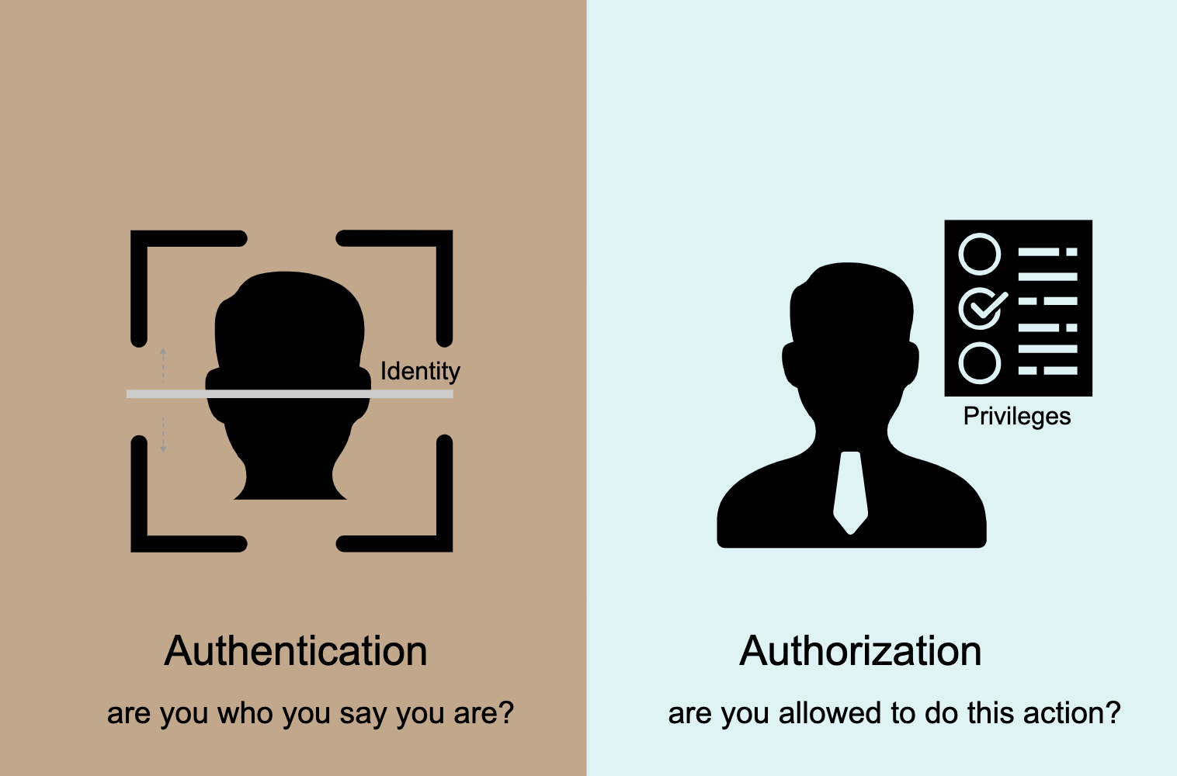
Authentication vs. authorization
Authenticated user logged in to your system and his credentials were verified.
Authorized user also logged in to your system and his credentials were verified, but his authorization permissions let him to specific parts of the system or let him do specified actions.

Slide 6
Authorization
Management of roles
Management of permissions
Way of storing this data for fast access

Slide 7
Authorization in REST
GET /products – returns all products – role ”any”
POST /products – add new products – role “product creator”
PUT /products – modify products – role “product modifier”
GET /landing – return content on the landing page – role “any”

Slide 8
But what if…?
Restrict user with specific role to update only description of the product
PUT /products/descriptionOnly ?!
PUT /products/descriptionAndPrice ?!
PUT /products/descriptionAndPriceAndImages ?!
PUT /product/descriptionAndSomeOtherAttributeWhichTheClientAmMakingEshopForWillChangeEveryWeekBecauseHeCanAndWantsTo ?!

Slide 9

But what if…?
Restrict user to access specific part of the system

Slide 10
There has to be a better way…

Slide 11
Authorization in graphql
GraphQL Shield - https://github.com/maticzav/graphql-shield
Custom solution from scratch

Slide 12
How we done it
Define permissions in database
Load “global permission tree” at start of the server
Load them to user’s session when he logs in
Authorize every query/mutation

Slide 13
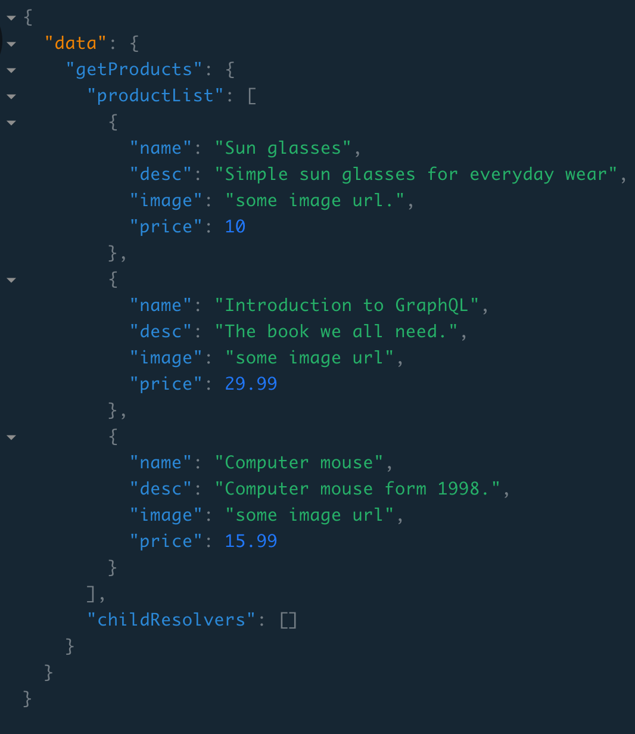
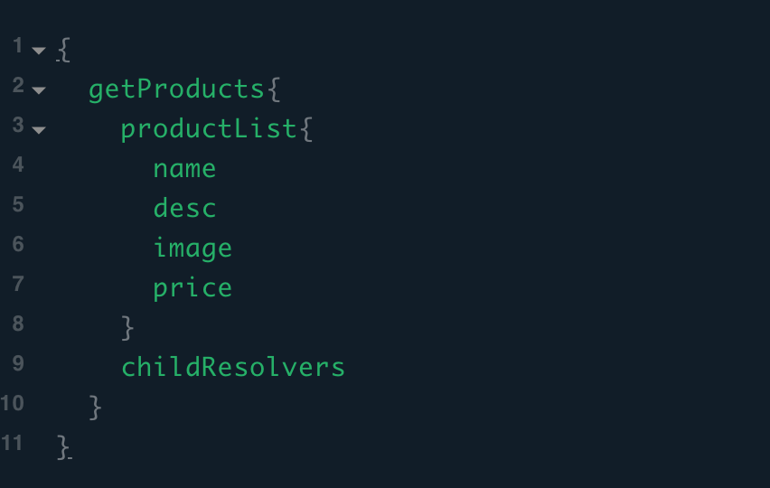
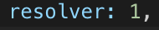
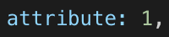
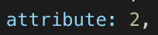

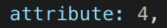
Example

Slide 14
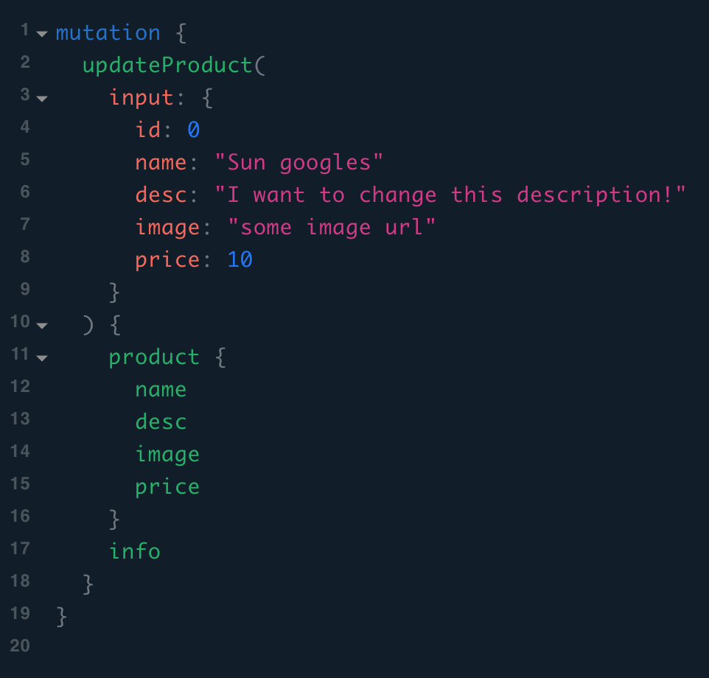
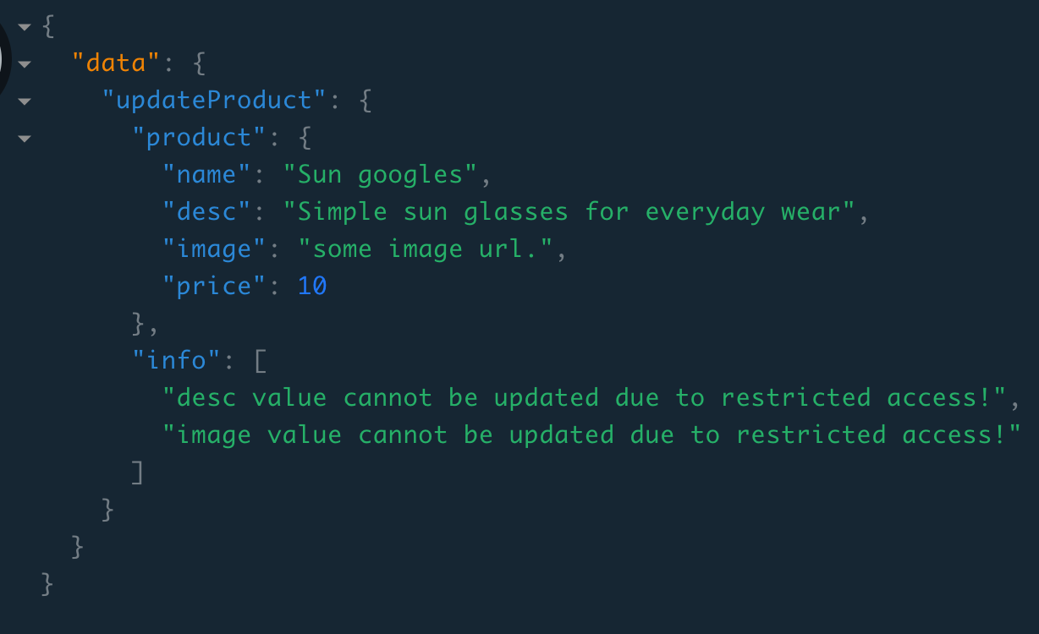


Slide 15
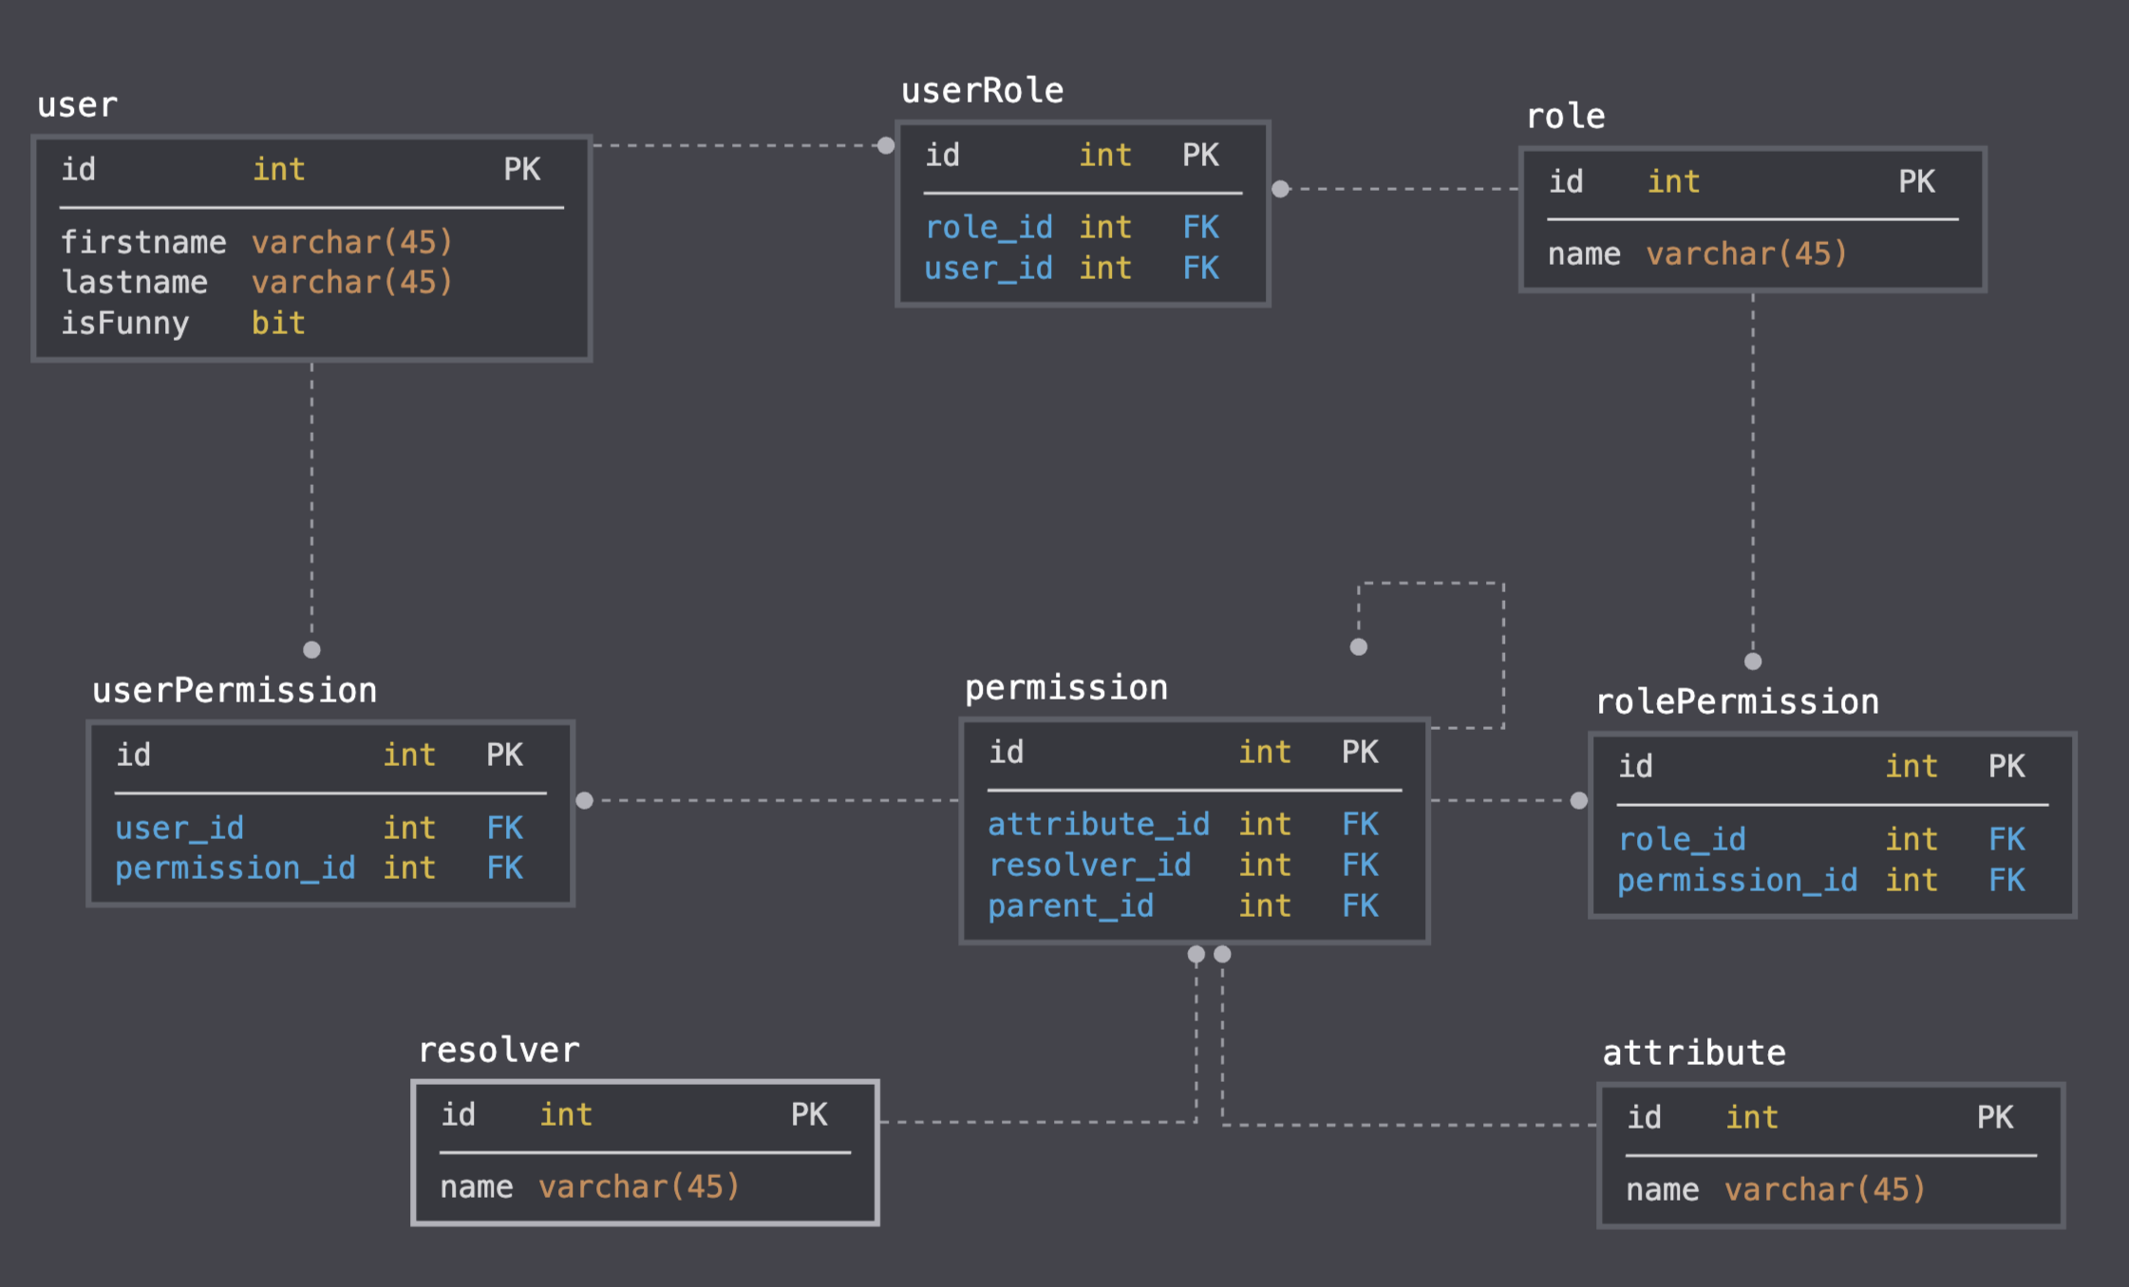
database

Slide 16
Demo
Example in demo (swipe right)

Slide 17
Questions ?

Slide 18
Suggestions ?
Please help us if you see flaw in the design!

Slide 19
Thank you for your attention
I lied about the bad jokes… Authorization is no joke!
Please feel free to contact me
jergus.frajt@naytrolabs.com

